Slide 1
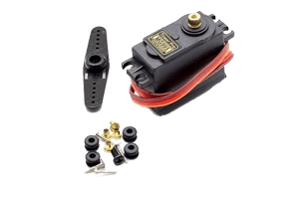
How Servo Motor Works & Interface It With Arduino
A servo motor is allows for control of angular position.
Servo is controlled on the concept of PWM (Pulse Width Modulation).
Hence if the range of motor angular position is from 0 to 180.
Then minimum pulse width corresponds to 0 and maximum pulse width corresponds to 180.

Slide 2
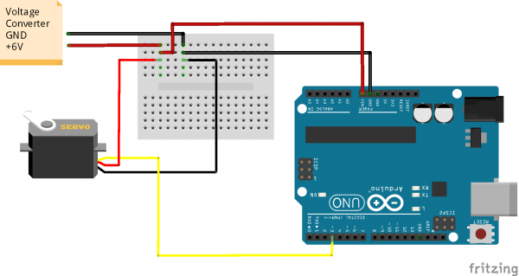
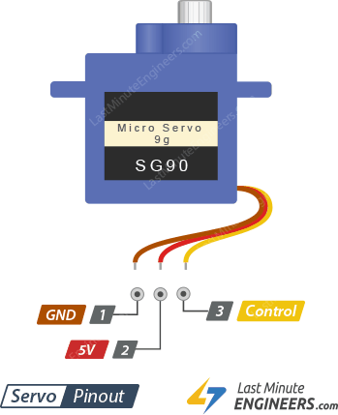
Controlling Servo using Arduino Uno
Arduino uno has 6 PWM pins: 3, 5, 6, 9, 10, and 11 which provide 8-bit PWM output with the analogWrite() function.
We will controlling servo using Pin 3.
A Servo pin has three wires (Order to be connected in evive, left to right)
Brown wire: GND
Red wire: VCC
Orange wire: Signal

Slide 3
Arduino Code
#include <Servo.h>
int servoPin = 9;
Servo servo;
int angle = 0; // servo position in degrees
void setup() {
servo.attach(servoPin);
}
void loop() {
// scan from 0 to 180 degrees
for(angle = 0; angle < 180; angle++) {
servo.write(angle);
delay(15);
}
// now scan back from 180 to 0 degrees
for(angle = 180; angle > 0; angle--) {
servo.write(angle);
delay(15);
}
}

Slide 4
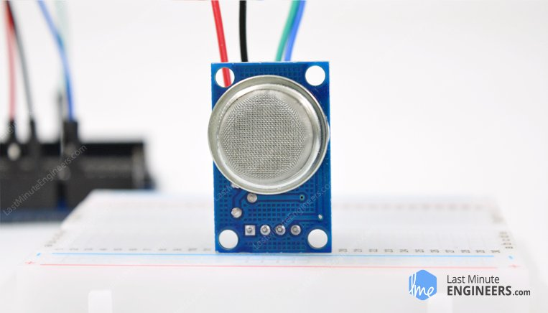
MQ2 Gas/Smoke Sensor Works with Arduino
This is a robust Gas sensor sensing LPG, Smoke, Alcohol, Propane, Hydrogen, Methane and Carbon Monoxide concentrations in the air.

Slide 5
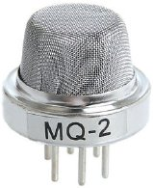
What is MQ2 Gas Sensor?
MQ2 is one of the commonly used gas sensors in MQ sensor series.
It is a Metal Oxide Semiconductor (MOS) type Gas Sensor also known as Chemiresistors.
MQ2 Gas sensor works on 5V DC and draws around 800mW. It can detect LPG, Smoke, Alcohol, Propane, Hydrogen, Methane and Carbon Monoxide concentrations anywhere from 200 to 10000ppm(parts per million).

Slide 7
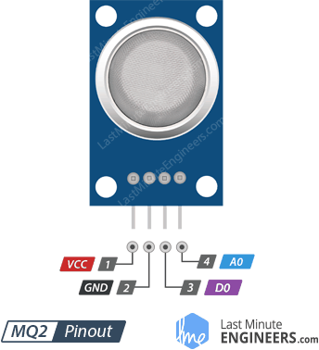
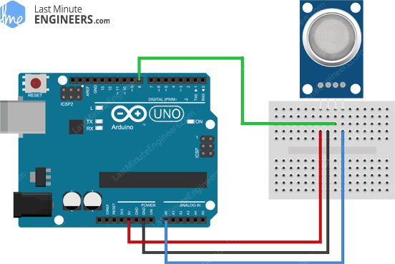

Slide 8
Arduino Code
int MQ2pin =A0;
float sensorValue; //variable to store sensor value
void setup() {
Serial.begin(9600); // sets the serial port to 9600
Serial.println("Gas sensor warming up!");
delay(20000); }
void loop() {
sensorValue = analogRead(MQ2pin); // read analog input pin 0
Serial.print("Sensor Value: ");
Serial.print(sensorValue);
if(sensorValue > 300) {
Serial.print(" | Smoke detected!"); }
Serial.println("");
delay(2000); // wait 2s for next reading
}

Slide 9
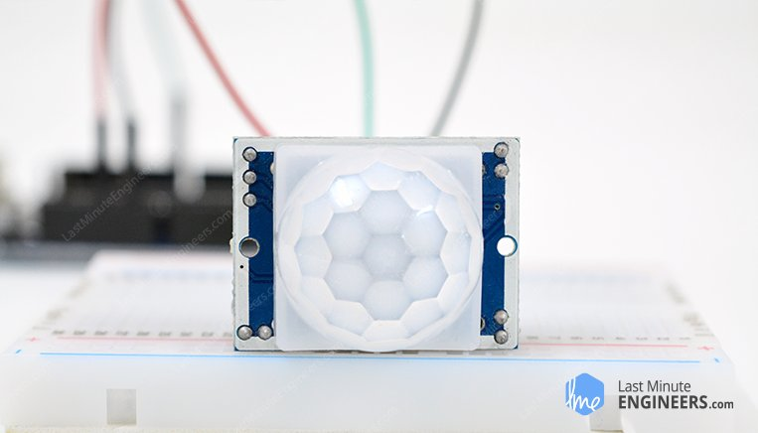
HC-SR501 PIR Sensor Works & Interface It With Arduino
Passive infrared (PIR) sensor. PIR sensors allow you to detect when someone is in your room when they shouldn’t be.
This sensor is the same you will find in most modern security systems, automatic light switches, garage door openers and similar applications

Slide 10
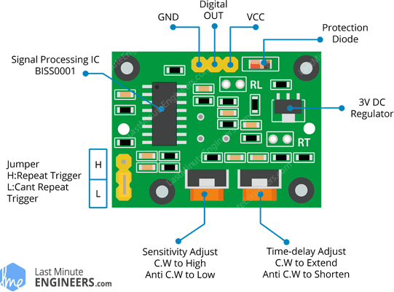
Sensitivity– This sets the maximum distance that motion can be detected. It ranges from 3 meters to approximately 7 meters
Time– This sets how long that the output will remain HIGH after detection. At minimum it is 3 seconds, at maximum it is 300 seconds or 5 minutes.
H– This is the Hold/Repeat/Retriggering In this position the HC-SR501 will continue to output a HIGH signal as long as it continues to detect movement.
L– This is the Intermittent or No-Repeat/Non-Retriggering In this position the output will stay HIGH for the period set by the TIME potentiometer adjustment.

Slide 11
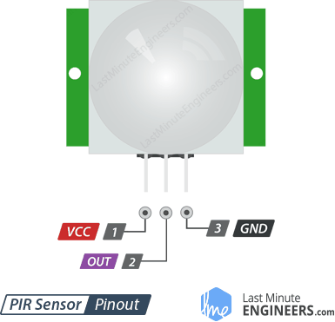
HC-SR501 PIR Sensor Pinout
The HC-SR501 has a 3-pin connector that interfaces it to the outside world. The connections are as follows:
VCC: is the power supply for HC-SR501 PIR sensor which we connect the 5V pin on the Arduino.
OUTPUT: pin is a 3.3V TTL logic output. LOW indicates no motion is detected, HIGH means some motion has been detected.
GND: should be connected to the ground of Arduino.

Slide 12
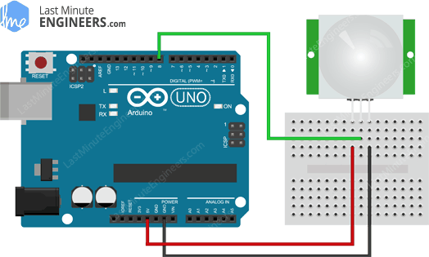
Wiring – Connecting PIR Sensor to Arduino UNO

Slide 13
Arduino Code
int ledPin = 13; // choose the pin for the LED
int inputPin = 8; // choose the input pin (for PIR sensor)
int pirState = LOW; // we start, assuming no motion detected
int val = 0; // variable for reading the pin status
void setup() {
pinMode(ledPin, OUTPUT); // declare LED as output
pinMode(inputPin, INPUT); // declare sensor as input
Serial.begin(9600);
}

Slide 14
void loop(){
val = digitalRead(inputPin); // read input value
if (val == HIGH) // check if the input is HIGH
{
digitalWrite(ledPin, HIGH); // turn LED ON
if (pirState == LOW) {
Serial.println("Motion detected!"); // print on output change
pirState = HIGH;
} }
else {
digitalWrite(ledPin, LOW); // turn LED OFF
if (pirState == HIGH) {
Serial.println("Motion ended!"); // print on output change
pirState = LOW;
} } }

Slide 15
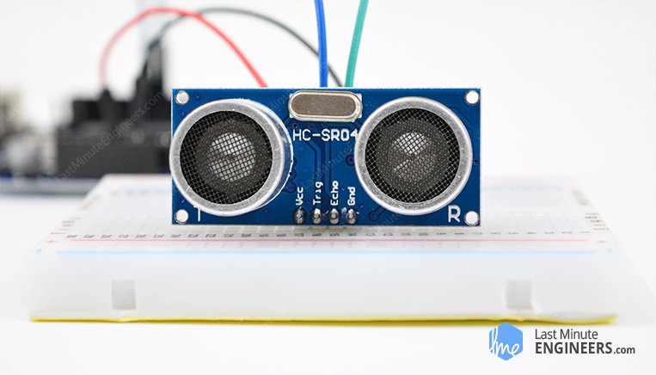
How HC-SR04 Ultrasonic Sensor Works & Interface It With Arduino
HC-SR04 Ultrasonic Distance Sensor that can report the range of objects up to 13 feet away.

Slide 16
specifications
Operating Voltage | DC 5V
Operating Current | 15mA
Operating Frequency | 40KHz
Max Range | 4m
Min Range | 2cm
Ranging Accuracy | 3mm
Measuring Angle | 15 degree
Trigger Input Signal | 10µS TTL pulse
Dimension | 45 x 20 x 15mm

Slide 17
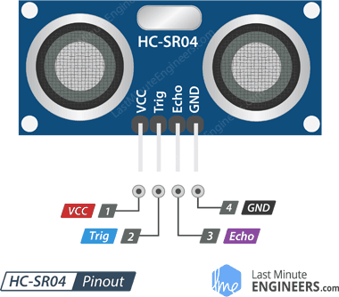
HC-SR04 Ultrasonic Sensor Pinout
VCC : is the power supply for HC-SR04 Ultrasonic distance sensor which we connect the 5V pin on the Arduino.
Trig : pin is used to trigger the ultrasonic sound pulses.
Echo : pin produces a pulse when the reflected signal is received. The length of the pulse is proportional to the time it took for the transmitted signal to be detected.
GND : should be connected to the ground of Arduino.

Slide 18
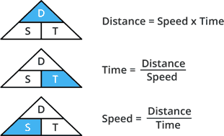
How Does HC-SR04 Ultrasonic Distance Sensor Work

Slide 19
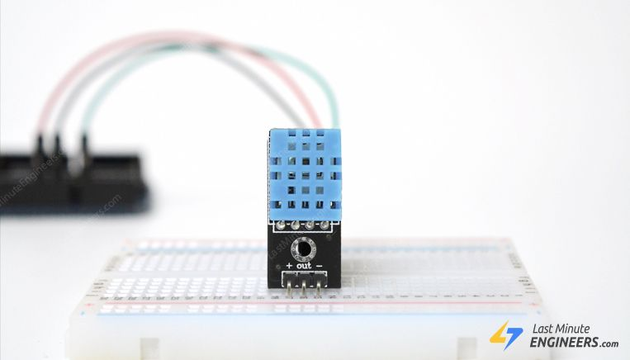
Interface DHT11 Module With Arduino

Slide 20
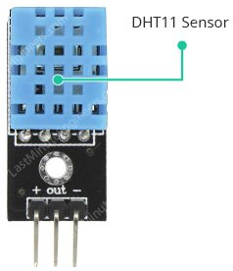
DHT11 can measure temperature from 0°C to 50°C with ±2.0°C accuracy, and humidity from 20 to 80% with 5% accuracy.

Slide 21
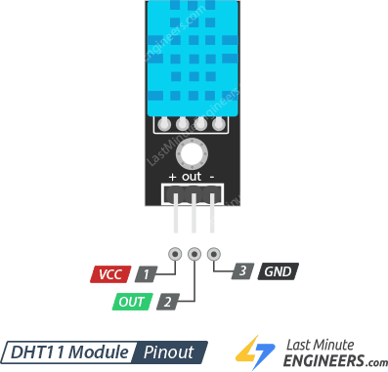
DHT11 Module Pinout
VCC : pin supplies power for the sensor. 5V supply is recommended, although the supply voltage ranges from 3.3V to 5.5V.
OUT : pin is used to communication between the sensor and the Arduino.
GND : should be connected to the ground of Arduino.

Slide 22
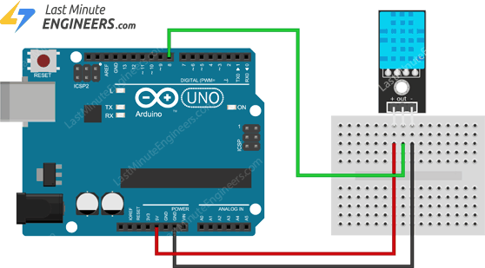

Slide 23
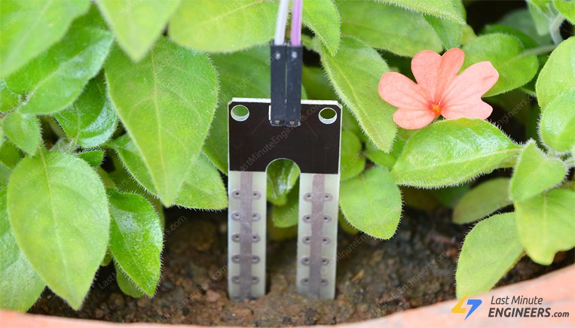
How Soil Moisture Sensor Works and Interface it with Arduino

Slide 24
resistance varies according to the water content in the soil.
The more water in the soil means better conductivity and will result in a lower resistance.
The less water in the soil means poor conductivity and will result in a higher resistance.

Slide 25
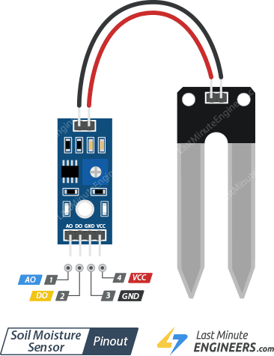
Soil Moisture Sensor Pinout

Slide 26
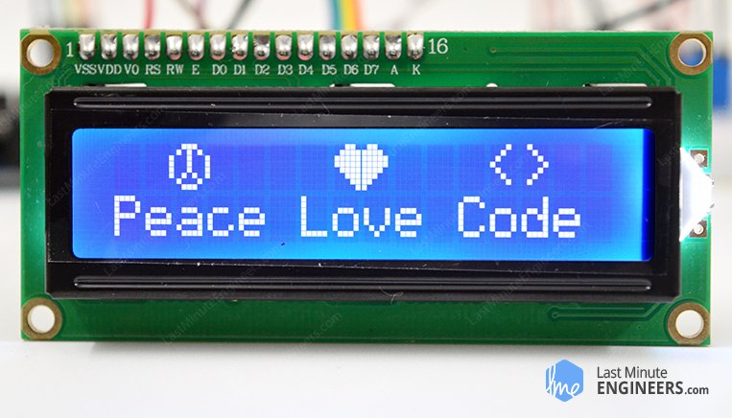
Interfacing 16×2 Character LCD Module with Arduino
An LCD is short for Liquid Crystal Display. It is basically a display unit which uses liquid crystals to produce a visible image.

Slide 27
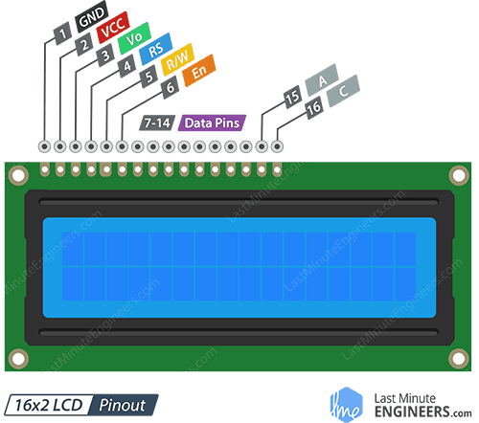
16×2 Character LCD Pinout

Slide 28
GND : should be connected to the ground of Arduino.
VCC : is the power supply for the LCD which we connect the 5 volts pin on the Arduino.
V0 (LCD Contrast) : controls the contrast and brightness of the LCD. Using a simple voltage divider with a potentiometer, we can make fine adjustments to the contrast.
RS (Register Select): pin lets the Arduino tell the LCD whether it is sending commands or the data. Basically this pin is used to differentiate commands from the data.
For example, when RS pin is set to LOW, then we are sending commands to the LCD And when RS pin is set on HIGH we are sending data/characters to the LCD.
R/W (Read/Write): you’re reading data from the LCD or writing data to the LCD. Since we’re just using this LCD as an OUTPUT device, we’re going to tie this pin LOW. This forces it into the WRITE mode.
E (Enable) : pin is used to enable the display. Meaning, when this pin is set to LOW, the LCD does not care what is happening with R/W, RS, and the data bus lines; when this pin is set to HIGH, the LCD is processing the incoming data.
D0-D7 (Data Bus): are the pins that carries the 8 bit data we send to the display.
A-K (Anode & Cathode) : pins are used to control the backlight of the LCD.

Slide 29
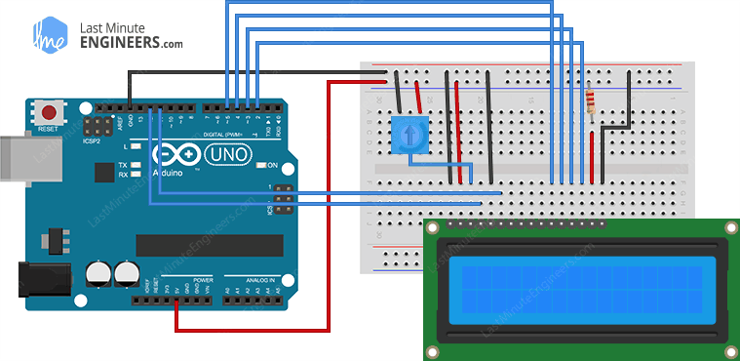
Wiring – Connecting 16×2 Character LCD with Arduino Uno

Slide 30
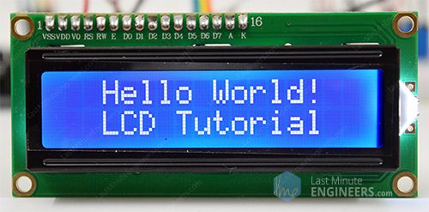
Arduino Code
// include the library code:
#include <LiquidCrystal.h>
// Creates an LCD object. Parameters: (rs, enable, d4, d5, d6, d7)
LiquidCrystal lcd(12, 11, 5, 4, 3, 2);
void setup() {
// set up the LCD's number of columns and rows:
lcd.begin(16, 2);
// Clears the LCD screen
lcd.clear();
}
void loop() {
// Print a message to the LCD.
lcd.print(" Hello world!");
// set the cursor to column 0, line 1
// (note: line 1 is the second row, since counting begins with 0):
lcd.setCursor(0, 1);
// Print a message to the LCD.
lcd.print(" LCD Tutorial");
}

Slide 31
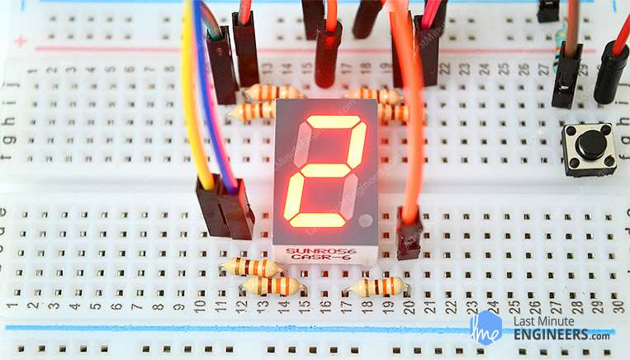
How Seven Segment Display Works & Interface it with Arduino
seven-segment displays most practical way to display numbers. They are easy to use, cost effective and highly readable, both in limited light conditions and in strong sunlight.

Slide 32
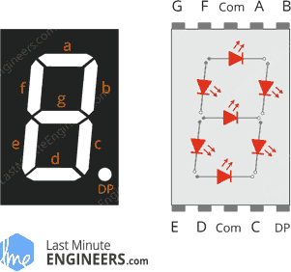
Hardware Overview
The 7-segment displays are really just seven LEDs lined up in a particular pattern.
Each of the seven LEDs is called a segment. the segment forms part of a numerical digit (both Decimal and Hex) to be displayed.
An additional 8th LED is sometimes used for indication of a decimal point.

Slide 33
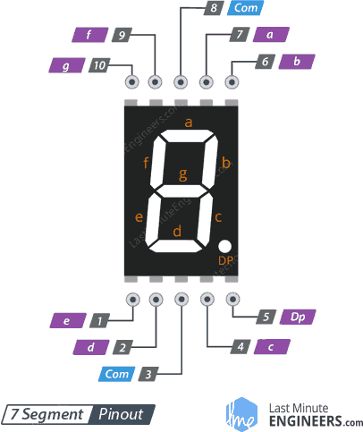
7 Segment Display Pinout
a-g &DP : Out of 10, the 8 pins i.e. a, b, c, d, e, f, g and DP segment (decimal point) are connected to digital pins of Arduino. By controlling each LED on the segment connected, numbers can be displayed.
COM: The pin 3 and 8 are internally connected to form a common pin. This pin should be connected to GND (common cathode) or 5V (common anode) depending upon the type of the display.

Slide 34
Common Cathode(CC) Vs Common Anode(CA)
Seven segment displays are of two types: Common Cathode (CC) and Common Anode (CA).
Internal structure of both types is nearly the same.
The difference is the polarity of the LEDs and common terminal.
the common cathode has all the cathodes of the LEDs in a 7-segment connected
the common anode has all the anodes of the LEDs in a 7-segment connected together.

Slide 35
In the common cathode display, all the cathode connections of the LED segments are connected together to ‘logic 0’ / GND.
The individual segments are then illuminated by applying HIGH / ’logic 1’ signal to the individual Anode terminals (a-g).

Slide 36
In the common anode display, all the anode connections of the LED segments are joined together to logic “1”.
The individual segments are illuminated by applying a ground, logic “0” or “LOW” signal to the Cathode of the particular segment (a-g).

Slide 37
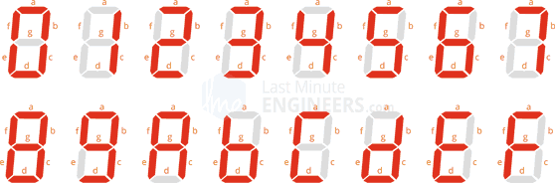
How 7 Segment Display Works?
the various digits from ‘0 through 9’ and characters from ‘A through F’ can be displayed using a 7-segment display

Slide 38
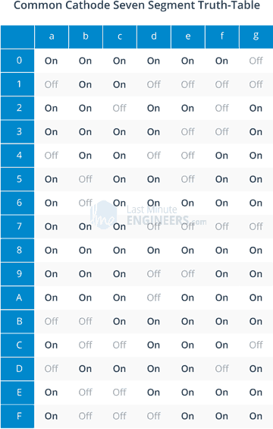
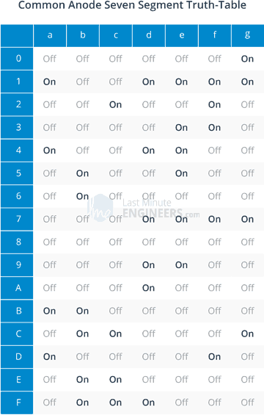

Slide 39
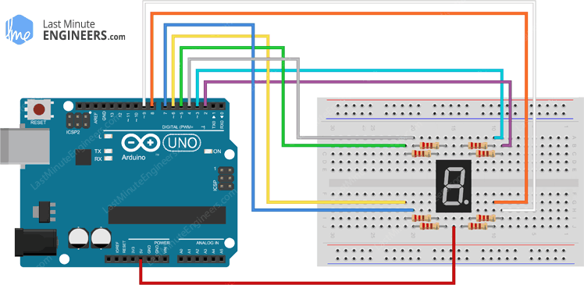
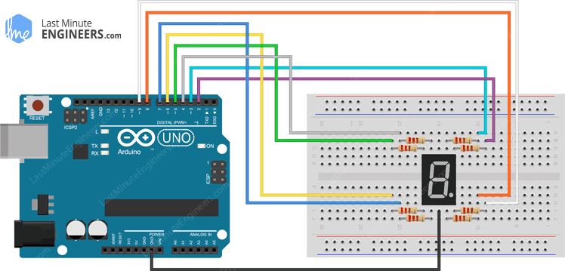
Wiring – Connecting 7 Segment Display to Arduino UNO
Wiring Common Anode Seven Segment Display to Arduino UNO
Wiring Common Cathode Seven Segment Display to Arduino UNO

Slide 40
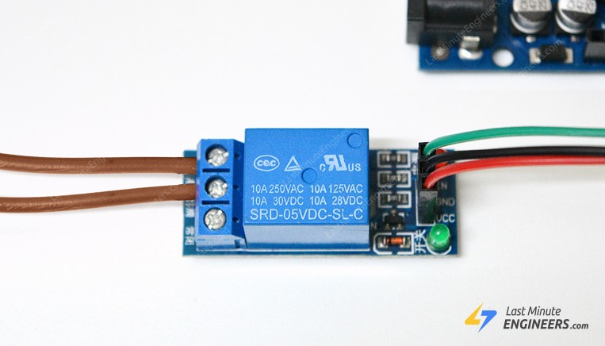
Interface One Channel Relay Module with Arduino
Sometimes you want your Arduino to control AC powered devices like lamps, fans or other household devices.
But because the Arduino operates at 5 volts, it cannot directly control these higher voltage devices.
That’s where the relay module comes in. You can use a relay module to control the AC mains and Arduino to control the relay.

Slide 41
How Do Relays Work?
A relay is an electromagnetic switch operated by a relatively small current that can control much larger current.
Initially the first circuit is switched off and no current flows through it until something. The second circuit is also switched off.
When a small current flows through the first circuit, it activates the electromagnet, which generates a magnetic field all around it.

Slide 42
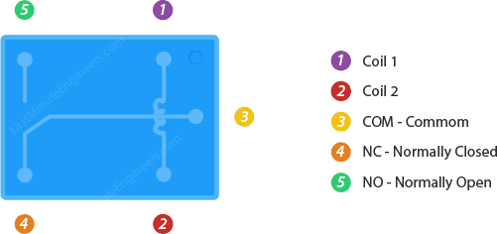
Relay Basics
Typically the relay has 5 pins, three of them are high voltage terminals (NC, COM, and NO) that connect to the device you want to control.
The mains electricity enters the relay at the common (COM) terminal. While use of NC & NO terminals depends upon whether you want to turn the device ON or OFF.
Between the remaining two pins (coil1 and coil2), there is a coil that acts like an electromagnet.

Slide 43
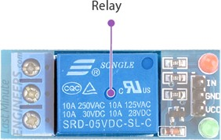
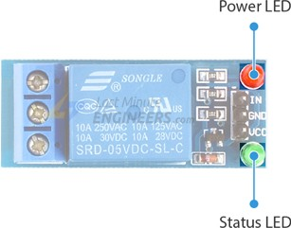
One Channel Relay Module
This module is designed for switching only a single high powered device from your Arduino. It has a relay rated up to 10A per channel at 250VAC or 30VDC.
LEDs
The Power LED will light up when the module is powered. The Status LED will light up when the relay is activated.

Slide 44
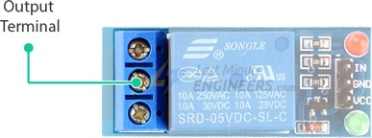
Output Terminal Block
We have three channels of the relay broken out to blue screw pin terminals. The channels are labelled for their function: common (COM), normally closed (NC), and normally open (NO)
COM (Common): This is the pin you should connect to the signal (mains electricity in our case) you are planning to switch.
NC (Normally Closed): A normally closed configuration is used when you want to turn off the relay by default. In this configuration the relay is always closed and remains closed until you send a signal from the Arduino to the relay module to open the circuit.
NO (Normally Open): A normally open configuration works the other way in which the relay is always open until you send a signal from the Arduino to the relay module to close the circuit.

Slide 45
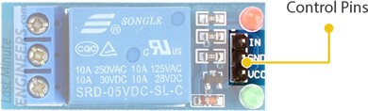
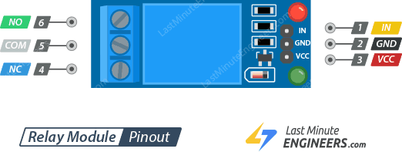
Control Pins
On the other side of the module, there are three pins – a Ground pin and a VCC pin to power the module and an input pin IN to control the relay.
pin is used to control the relay. It is an active low pin, meaning the relay will be activated when you pull the pin LOW and it will become inactive when you pull the pin HIGH.

Slide 46
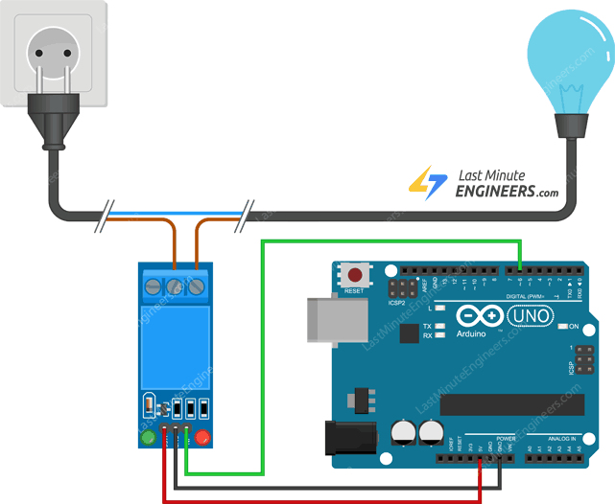
Wiring One Channel Relay Module with Arduino UNO

Slide 47
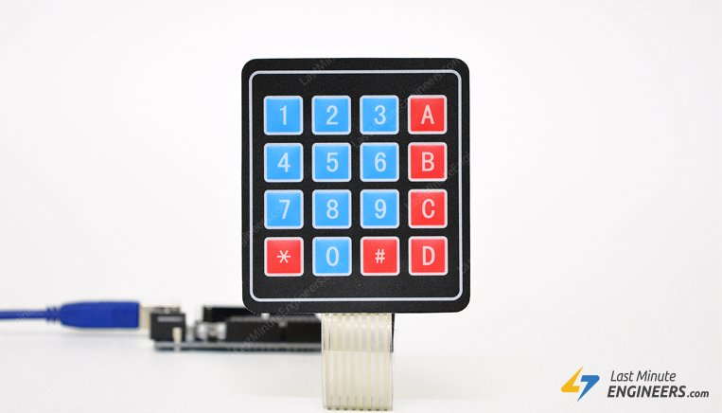
Interface 4×4 Keypad with Arduino
Matrix keypads are the kind of keypads you see on cell phones, calculators, microwaves ovens, door locks, etc. They’re practically everywhere.

Slide 48
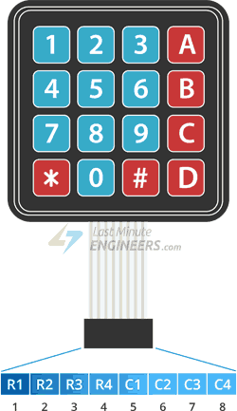
Pinout of 4×4 Keypad
Pressing a button shorts one of the row lines to one of the column lines
For example, when key ‘4’ is pressed, column 1 and row 2 are shorted.

Slide 49
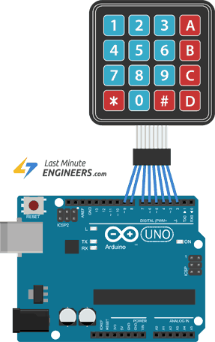
Wiring 4×4 Keypad with Arduino

Slide 50
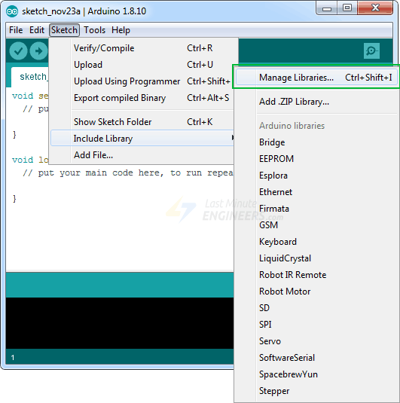
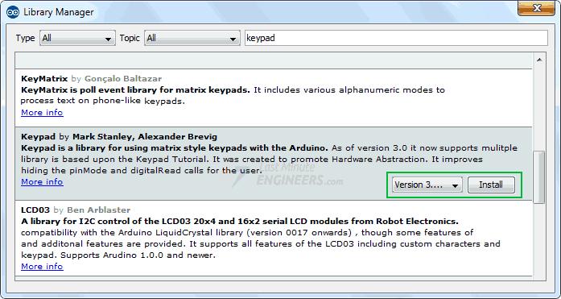
Installing Keypad Library

Slide 51
Arduino Code
#include <Keypad.h>
const byte ROWS = 4;
const byte COLS = 4;
char keys[ROWS][COLS] = {
{'1','2','3','A'},
{'4','5','6','B'},
{'7','8','9','C'},
{'*','0','#','D'}
};
byte rowPins[ROWS] = {9, 8, 7, 6};
byte colPins[COLS] = {5, 4, 3, 2};
Keypad keypad = Keypad( makeKeymap(keys), rowPins, colPins, ROWS, COLS );
void setup(){
Serial.begin(9600);
}
void loop(){
char key = keypad.getKey();// Read the key
if (key){
Serial.print("Key Pressed : ");
Serial.println(key);
}
}

